Slide 1
Guidelines
This template contains 2 master themes: Dark and Human
  Dark: 11 pages (7 cover pages, 1 start page, 1 content page, 1 contact page, 1 back cover)
  Human: 5 pages (1 cover page, 1 start page, 1 content page, 1 contact page, 1 back cover)
You can create a new slide and right click to choose one framework from “Layout” section.
Go to “Slide Master” mode in “View” section in case you want to adjust the framework.

Slide 11
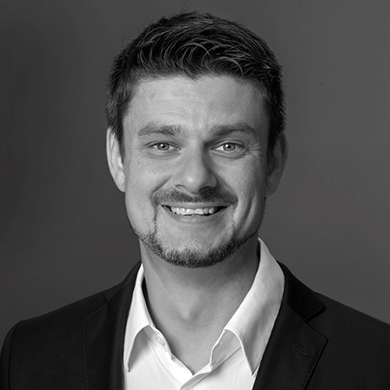
Thomas Stoesser
Director Marketing, Sales, Marketing and Administration
xxxxxxxxxxxxxxxx
xxxxxxxxxxxxxxxx

