Slide 1
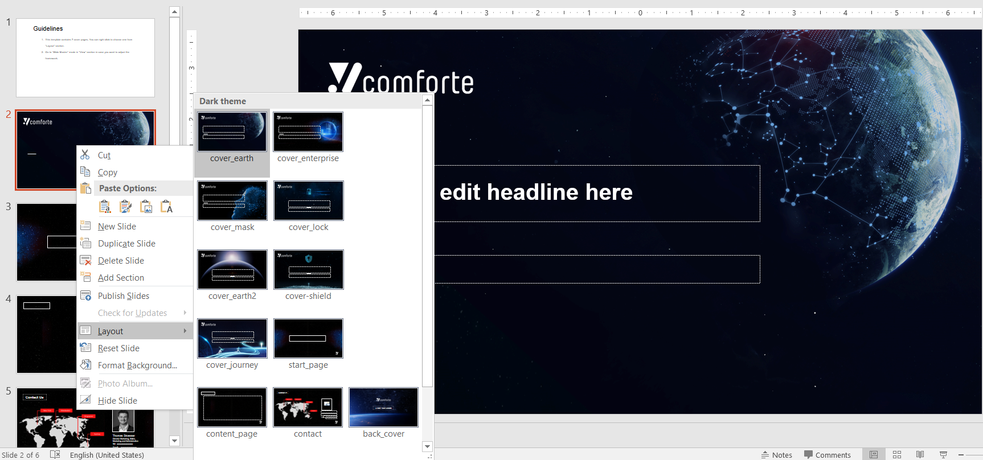
Guidelines
This template contains 7 cover pages, You can right click to choose one from “Layout” section.
Go to “Slide Master” mode in “View” section in case you want to adjust the framework.

Slide 5
Thomas Stoesser
Director Marketing, Sales, Marketing and Administration
xxxxxxxxxxxxxxxx
xxxxxxxxxxxxxxxx

